Slide 1
Tableau for
Data Visualization
MIS 634
Business Intelligence & Data Integration - LAB

Slide 2

Data Visualization Tools

Slide 3
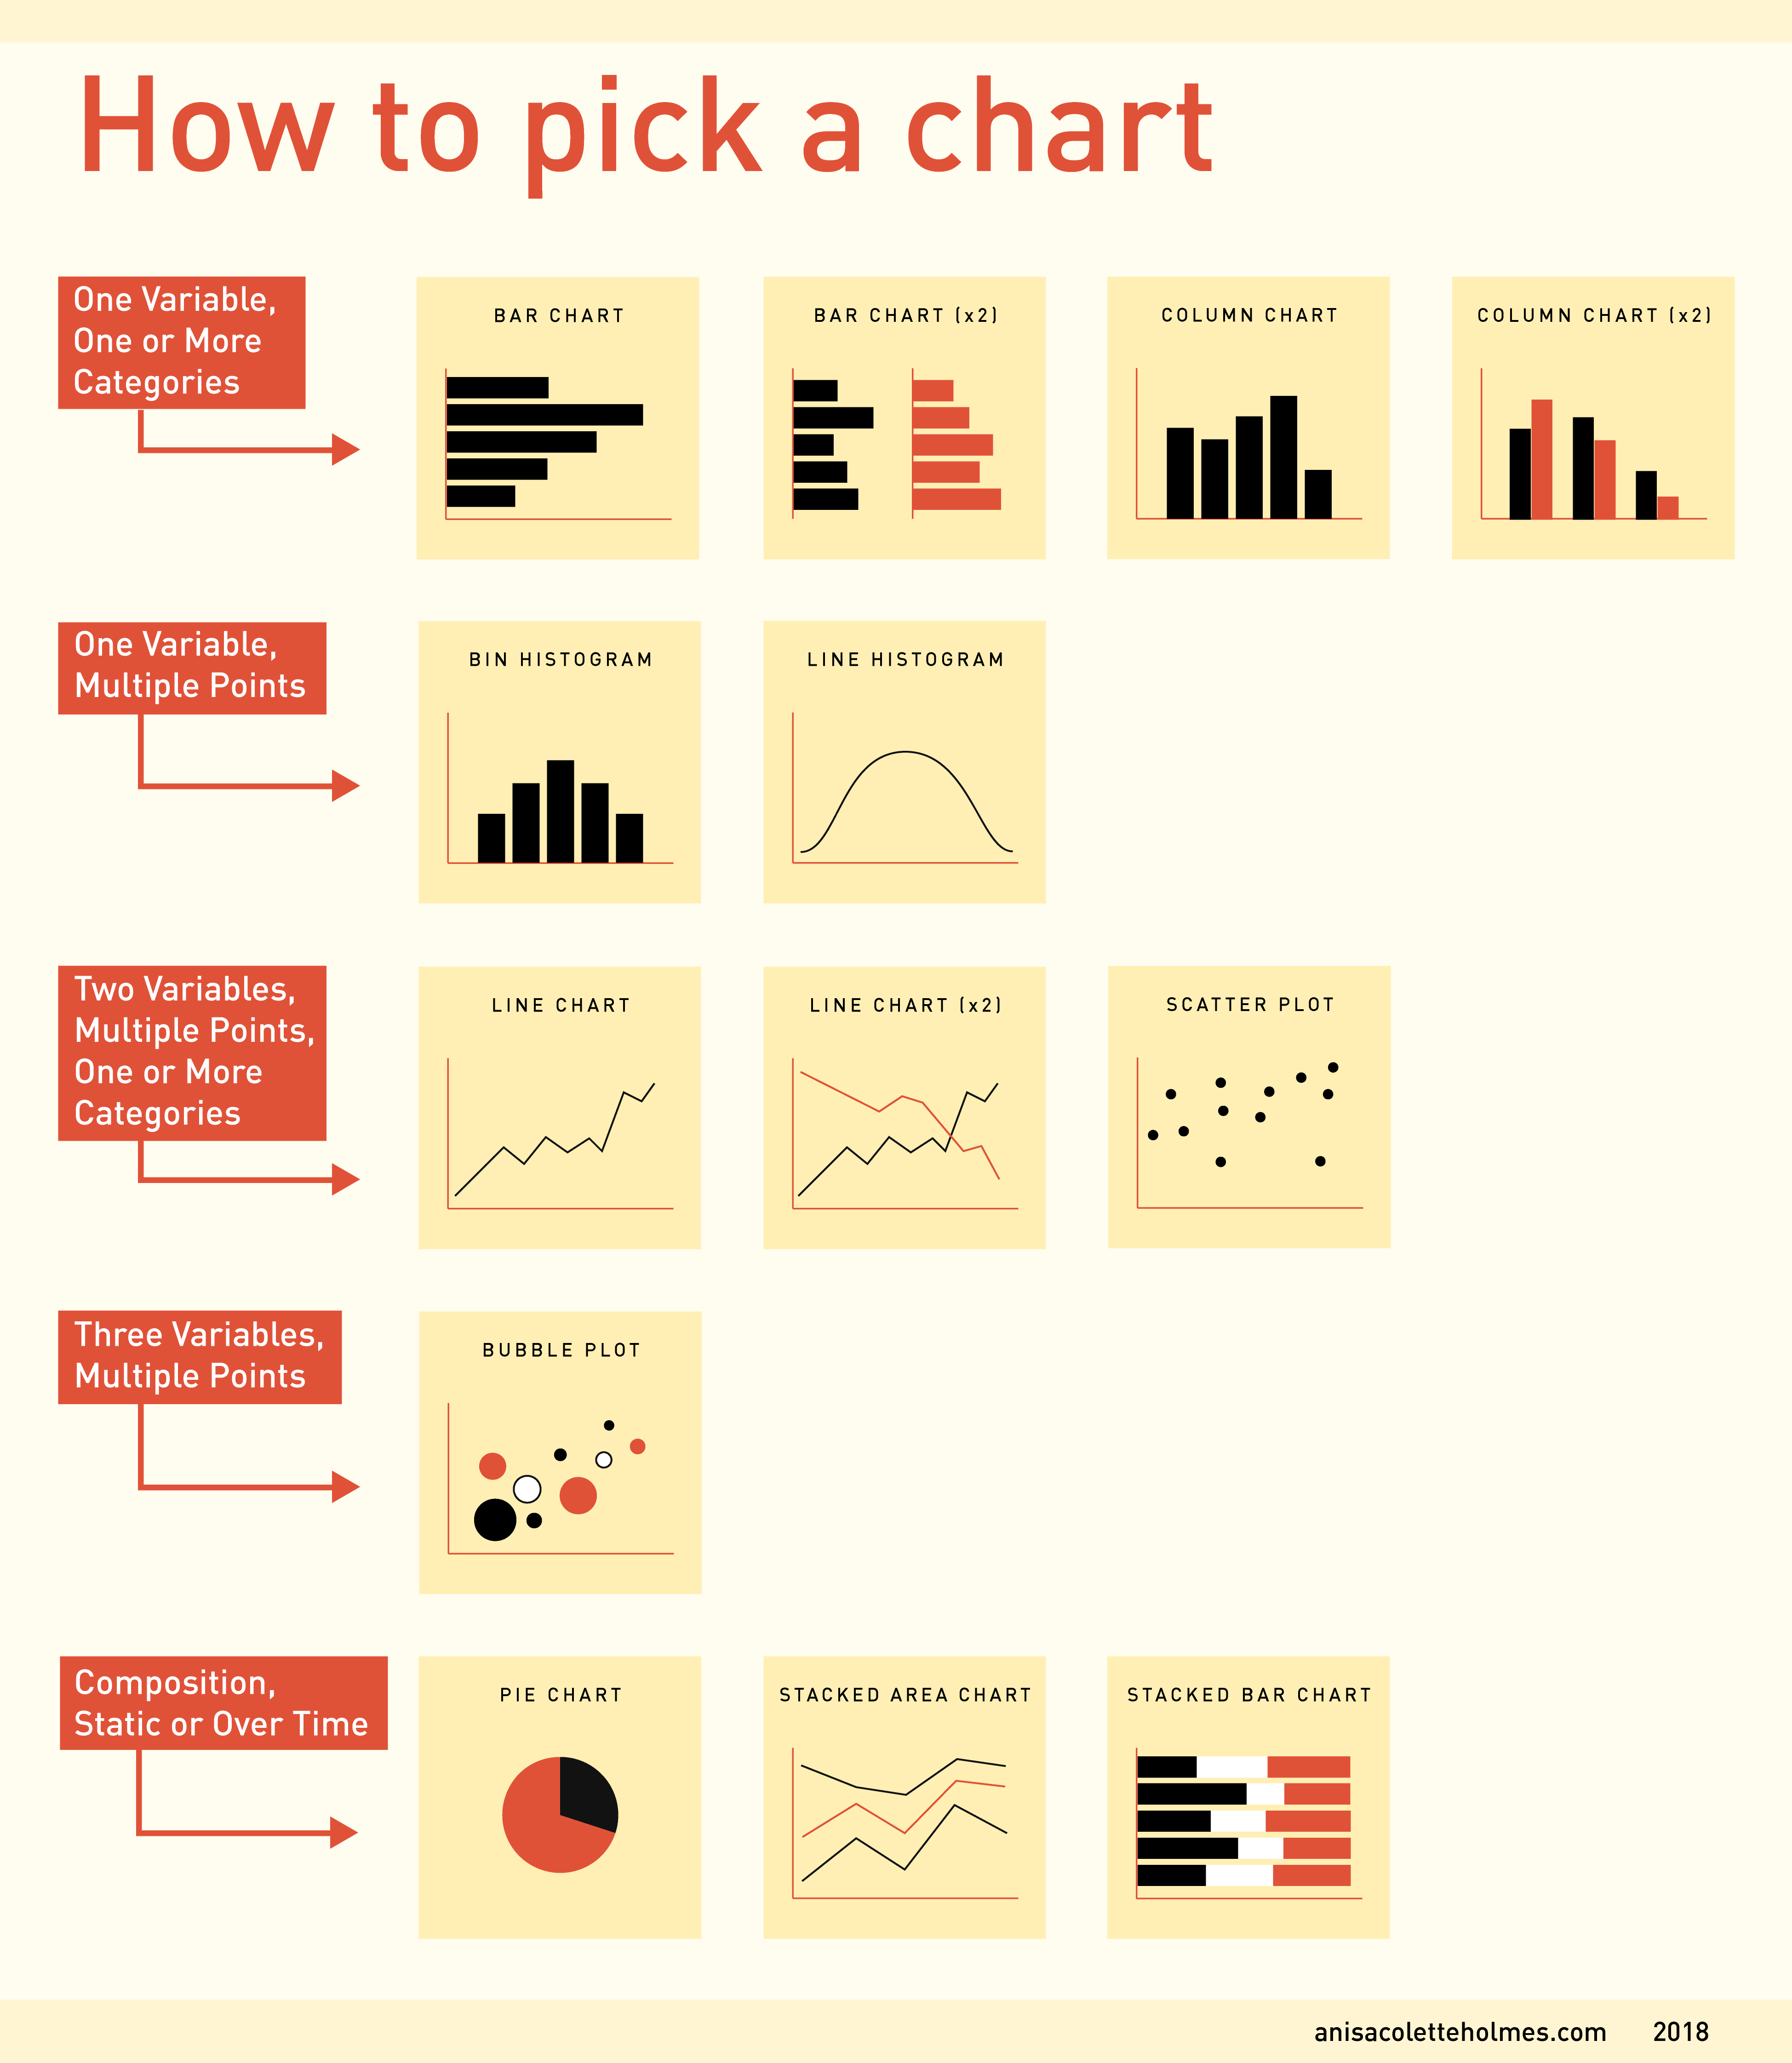
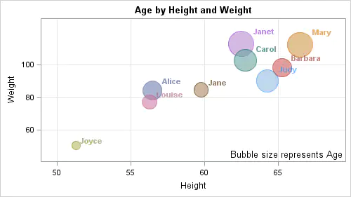
Data Visualization
https://www.interhacktives.com/2018/12/12/data-visualisation-checklist-7-things-to-check-before-you-click-publish/charts-01/

Slide 4
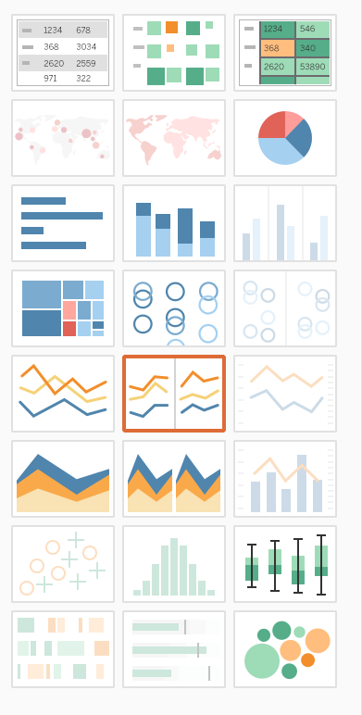
Charts & Graphs in Tableau
Reading:
Which Type of Chart or Graph is Right for You?
https://www.tableau.com/learn/whitepapers/which-chart-or-graph-is-right-for-you

Slide 5
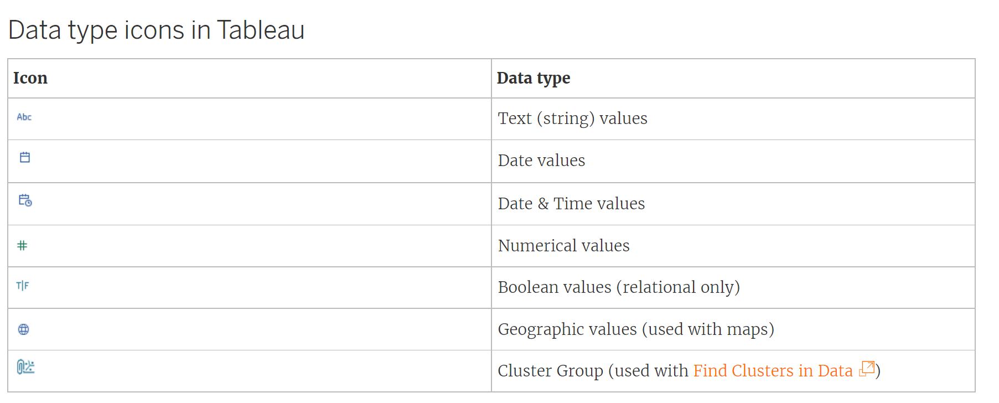
Data Types in Tableau

Slide 6
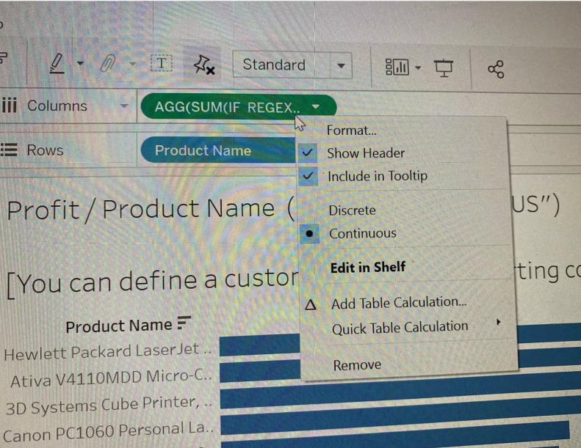

Function in Tableau
Aggregation Functions: AVG; COUNT; MAX etc.
The function in the example:
SUM(IF REGEXP_MATCH([Order ID],"US")
== TRUE Then([Profit]) END)
AVG(IF CONTAINS([Order ID],"US") Then [Profit] END)
Function in Tableau
https://help.tableau.com/current/pro/desktop/en-us/functions.htm
https://www.absentdata.com/tableau-function-list/
Logical Functions: AND; OR; IF-ELSE; etc.
String Functions: CONTAINS; ENDSWITH;FIND; etc.

Slide 7
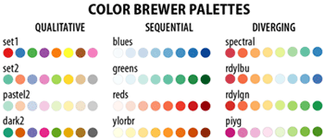
Dashboard in Tableau
Title/ Summary
Main Metrics & Charts
Layout
Color:
Tool for choosing color:
https://colorbrewer2.org/#type=sequential&scheme=Oranges&n=3
Fonts/ Size/ Line Spacing etc.

Slide 8
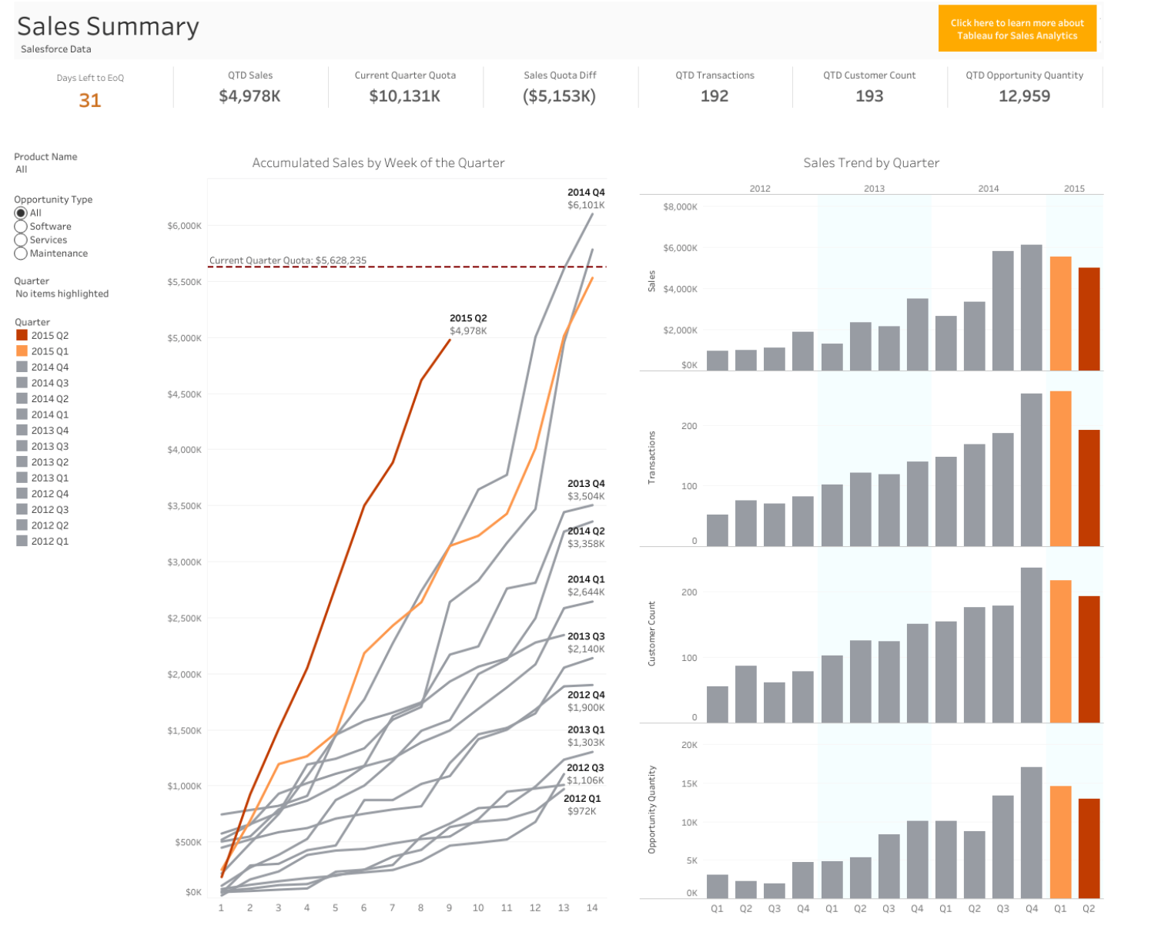
Dashboard in Tableau

Slide 9
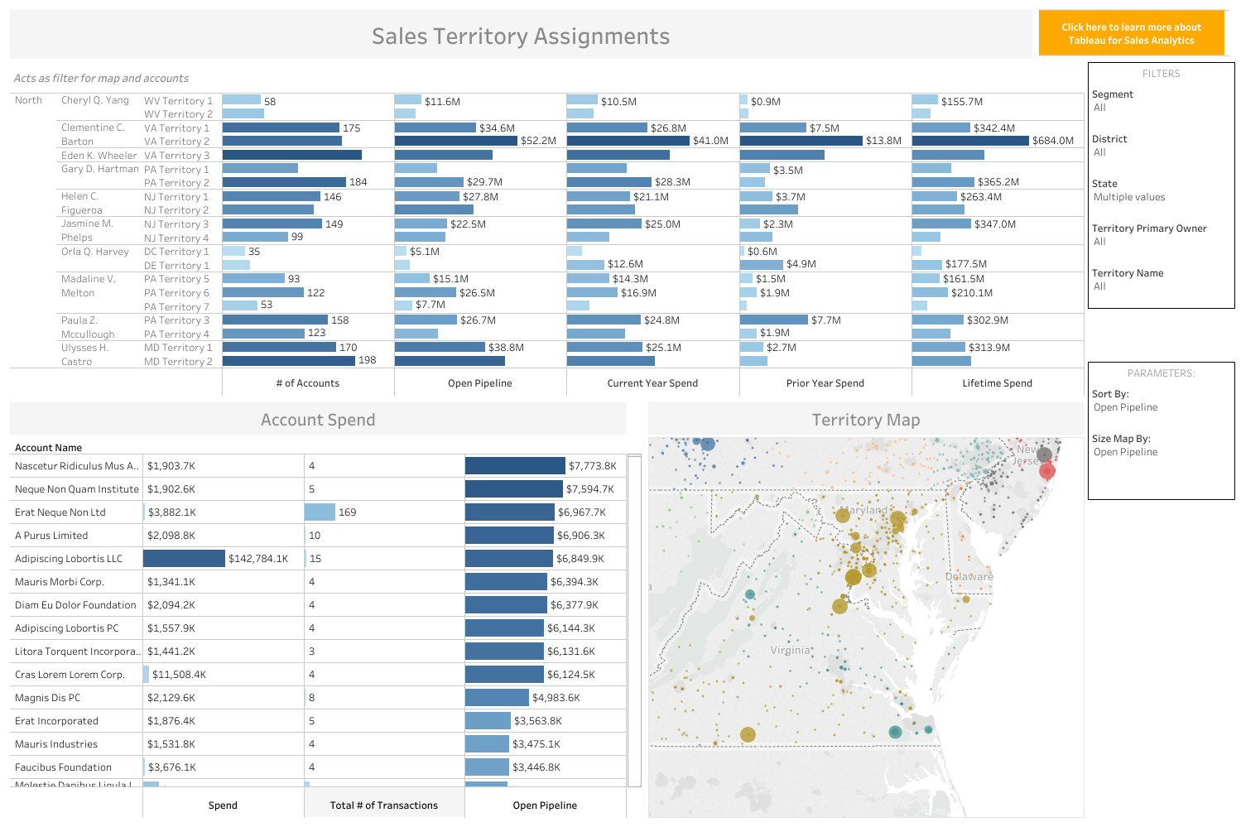
Dashboard in Tableau

Slide 10
Exercise I
Reading: (1) Data Visualization from UC Berkely Library https://guides.lib.berkeley.edu/data-visualization/about
(2) Which Type of Chart or Graph is Right for You? https://www.tableau.com/learn/whitepapers/which-chart-or-graph-is-right-for-you
(3) Function in Tableau https://help.tableau.com/current/pro/desktop/en-us/functions.htm
https://www.absentdata.com/tableau-function-list/
(4) 7 Great Examples & Templates Of Sales Dashboards https://www.tableau.com/learn/articles/sales-dashboards-examples-and-templates

Slide 11
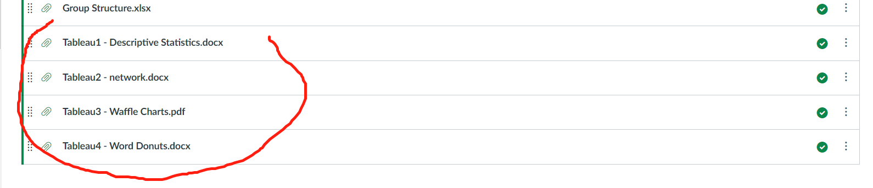
Exercise II
Go through the Tableau postings in 633 Canvas.

Slide 12
Exercise III (1/2)
Complete the following tasks with Tableau with nasa-meteorite.csv
Create a Calculated Field to display weight of meteorites by tons
1. Create a new calculated field named “Tons”
2. Divide Mass by 907185
Create a Bar Chart to display largest meteorites by location
1. Create a new sheet titled “Meteorite by City”
2. Create horizontal bar graph of fallen meteorites by city using the City dimension and Tons measure
3. Sort the graph in descending order using the axis sort icon
4. Filter the graph to only show top 10 largest (mass) fallen meteorites by city using the Top N filter feature

Slide 13
Exercise III (2/2)
Display meteorite landing locations using a map
1. Create a new sheet and name it “Meteorites by Location”
2. Create a Symbol Map using the Lat and Long dimensions
3. Change the size of each Mark using the Tons measure
4. Change the color of the Marks using the Fall dimension
5. Edit the ToolTip to include Tons, Year, City, and Fall Status
Create a dashboard that displays the sheets
1. Create a new Dashboard and name it “Meteorite Insights”
2. Check the box to show the title of the dashboard
3. Drag Meteorites by City to the view
4. Drag Meteorites by Location to the view
5. Display the legend in the same container as the map

Slide 14
Backup
Who is your audience?
Which sales KPIs should you focus on in the dashboard?
Is this dashboard connected to a live data source?
How do you plan to share this dashboard?
Reading: 7 Great Examples & Templates Of Sales Dashboards
https://www.tableau.com/learn/articles/sales-dashboards-examples-and-templates

